Slide 1
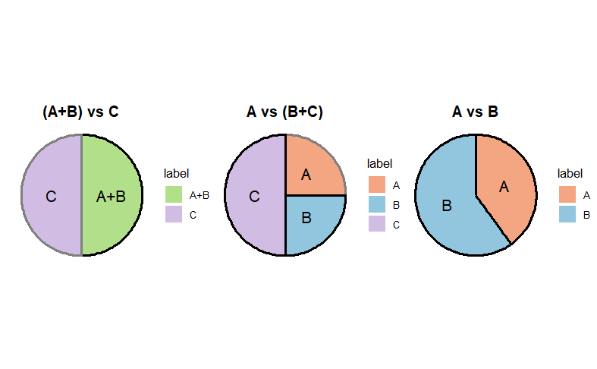
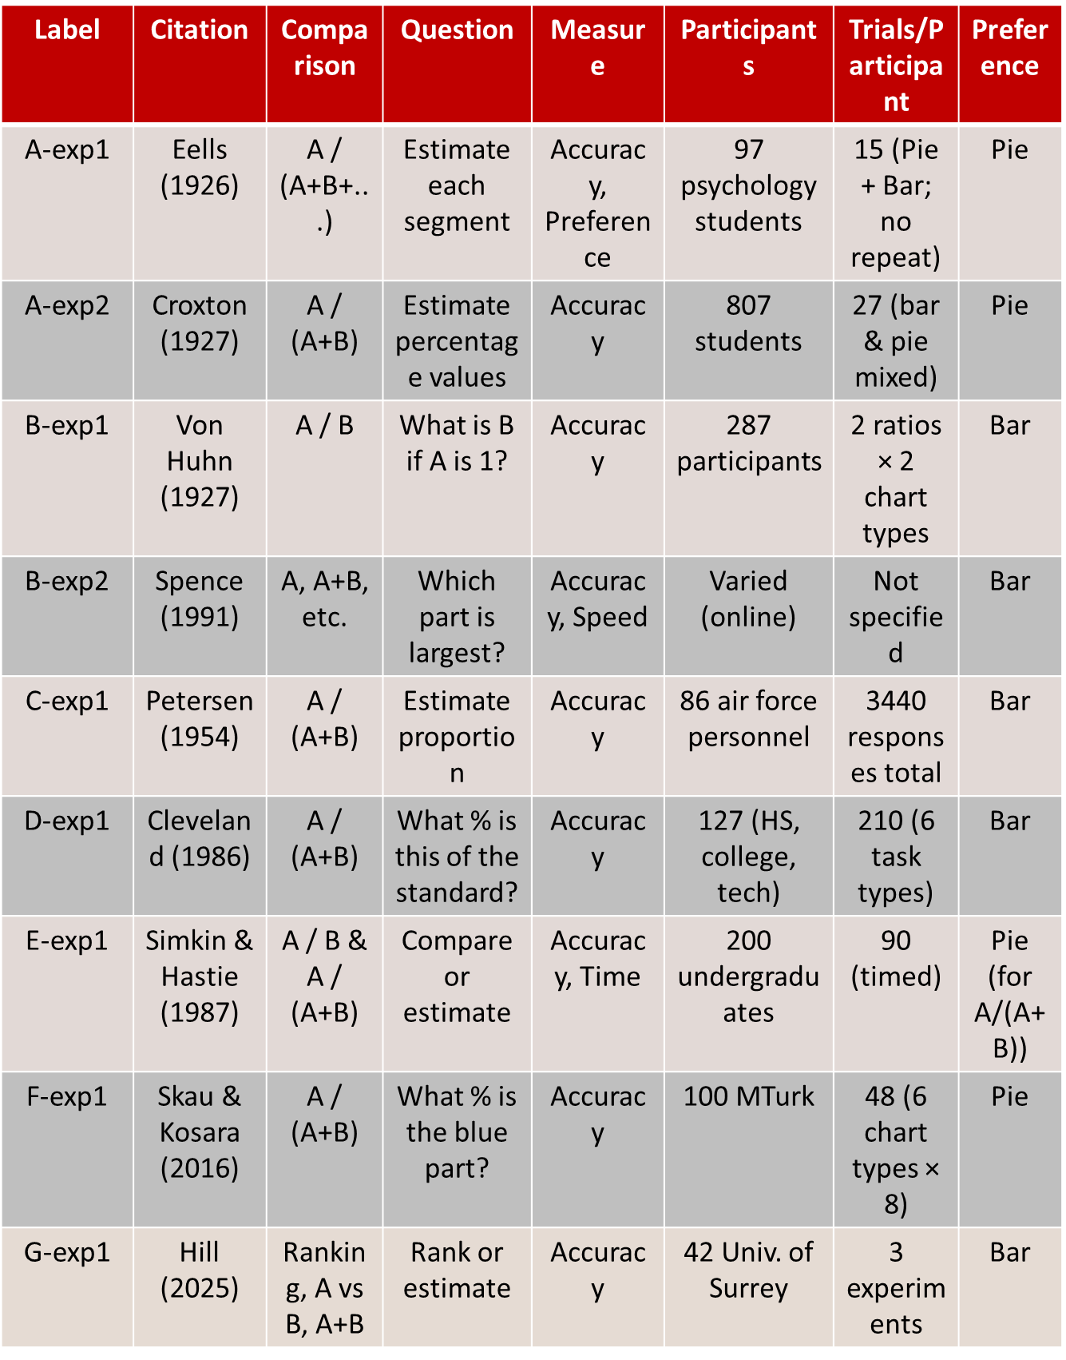
100 Years of Pies vs Bars
Maksuda Toma and Susan Vanderplas
Statistics Department, University of Nebraska Lincoln
Abstract
The debate between pie charts and bar charts has persisted for over a century, yet no definitive consensus has emerged regarding which is more effective. This poster offers a comprehensive summary of the historical and empirical literature, analyzing the strengths and limitations of each chart type. Pie and bar charts were introduced by William Playfair in the early 1800s. By the early 20th century, strong criticisms of pie charts appeared in textbooks and design manuals. Brinton (1914) and Karsten (1923), for example, labeled pie charts as cognitively inefficient and even insulting to the reader's intelligence. Eells (1926) noted that while the sector method (pie chart) was common, horizontal bar charts were favored for speed and accuracy. Despite longstanding criticism, pie charts remain widely used today. This work synthesizes findings from early visual perception studies through to modern experiments (Spence & Lewandowsky, 1991), highlighting that chart effectiveness often depends on task complexity. We aim to bridge historical insights with current empirical evidence to provide design guidance on when pie or bar charts are most appropriate.
Result
The effectiveness of pie, bar depends heavily on the task type. A vs B (Direct Comparison): Bar charts perform best in accuracy, speed, and user preference for comparing two values A / (A + B) (Part-to-Whole Estimation): Pie charts lead to more accurate judgments in part-to-whole tasks, especially with simple, adjacent segments. However, their advantage may decline when comparing non-adjacent slices in 3–4 component pies. A vs (B + C), A+B vs C+D (Grouped Comparison): Results are mixed. Bar charts are slightly better for A vs B+C, while pie charts outperform for grouped comparisons like A+B vs C+D Ranking Tasks: Bar charts enable faster and more accurate ranking of multiple parts due to clear alignment Magnitude Estimation: Pie and donut charts tend to support better intuitive magnitude judgments, although slight estimation errors are more common
Conclusion
Future Research
Summary of Experimental Studies on Chart Perception
Experimental Description
This project consolidates findings from more than a century of experimental research comparing pie charts and bar charts for part-whole data display. The emphasis is on the impact of chart style on human performance in tasks such as proportion estimation, component comparison, and ranking. Initial studies (Eells, 1926; Croxton, 1927) focused on challenges involving proportion estimation. Participants were instructed to estimate the percentage represented by a chart segment without being explicitly directed to compare segments. Eells' experiment involving 97 pupils employed both pie and bar charts to assess estimating accuracy, but Croxton's extensive study with 807 participants methodically evaluated matched bar and pie charts under different slice configurations. Both studies indicated that pie charts frequently yielded more precise calculations, particularly with portions of equal size or several components. Comparison-based activities ( Von Huhn, 1927) offered direct evaluations of A vs B, assessing individuals' ability to compare magnitudes effectively. In both small and high ratio scenarios, bar charts surpassed pie charts, indicating superior precision for exact magnitude comparisons. Contemporary research has broadened the scope of visual tasks. Spence and Lewandowsky (1991) and Simkin and Hastie (1987) conducted tasks such as A vs B plus C and A plus B versus C plus D, comparing various chart styles (bar, pie, table) under both timed and untimed settings. Their findings emphasized the significance of task type: bar charts excelled in direct comparisons and rankings, whereas pie charts were superior for proportion-to-whole estimations. Cleveland and MacGill (1984–1986) established the graphical perception framework, assessing the impact of visual encodings such as location, length, angle, and area on judgment accuracy. Their research, involving more than 120 people, uncovered a perceptual hierarchy: location and length exhibited the highest accuracy, whereas angle and area (as utilized in pie charts) were susceptible to greater inaccuracies. Skau & Kosara (2016) and Hill (2025) performed new online investigations that further analyzed perceptual biases and distortions. They demonstrated that deformed pie formats (e.g., exploded or elliptical pies) diminish accuracy, whereas regular pie charts continue to be remarkably effective in part-whole estimate tasks. Hill's research additionally investigated ranking and size estimation, confirming that no singular chart type excels universally across all tasks.
QUESTIONS?

